Slide 1
Logistic Regression
By
Daniel jadi
Data Scientist

Slide 2
Types of Logistic Regression
1. Binary Logistic Regression
The categorical response has only two 2 possible outcomes. Example: Spam or Not
2. Multinomial Logistic Regression
Three or more categories without ordering. Example: Predicting which food is preferred more (ex1:Veg, Non-Veg, Vegan, ex2: TRS,TDP,BJP,CONG,CPM)
3. Ordinal Logistic Regression
Three or more categories with ordering. Example: Movie rating from 1 to 5 or (Low, Medium and High)

Slide 3
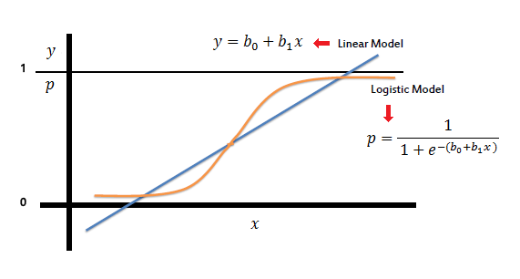
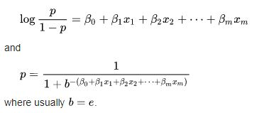
Logistic regression is a classification algorithm used to assign observations to a discrete set of classes.
Logistic regression models the data using the sigmoid function.
1) The sigmoid function’s range is bounded between 0 and 1. Thus it’s useful in calculating the probability for the Logistic function.
2) It’s derivative is easy to calculate than other functions which is useful during gradient descent calculation.
3) It is a simple way of introducing non-linearity to the model.

Slide 4

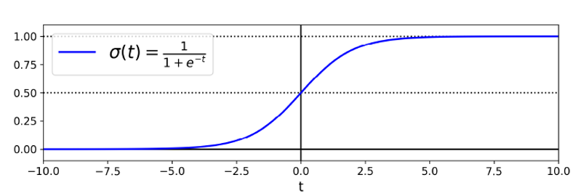
So, we can define conditional probabilities for 2 labels(0 and 1) for i^{th} observation as:

Slide 5
Assumptions of Logistic Regression
Binary Output Variable: Logistic regression is intended for binary (two-class) classification problems. It will predict the probability of an instance belonging to the default class, which can be snapped into a 0 or 1 classification.
Remove Noise: Logistic regression assumes no error in the output variable (y), consider removing outliers and possibly misclassified instances from your training data.
Gaussian Distribution: Logistic regression is a linear algorithm (with a non-linear transform on output). It does assume a linear relationship between the input variables with the output.We can use log, root, Box-Cox and other univariate transforms to better expose this relationship by data transform.
Remove Correlated Inputs: The model can overfit if you have multiple highly-correlated inputs. Consider calculating the pairwise correlations between all inputs and removing highly correlated inputs.

Slide 6
Thank you

